Slide 1
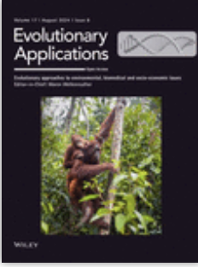
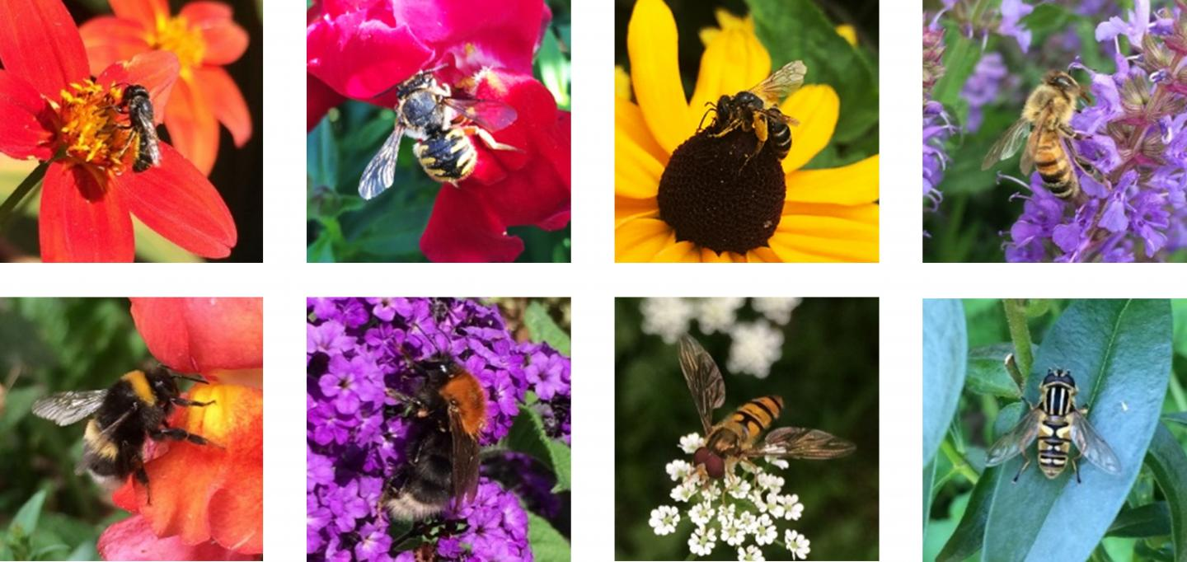
Special issue:
Call for original studies that describe evolutionary research on wild or managed insect pollinators and their pathogens, with relevance for improving management strategies.

