Slide 1
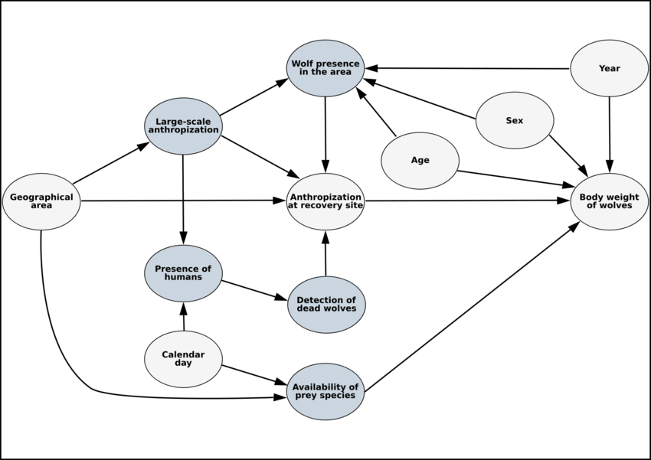
Structural Equation Modelling

Slide 2
General overview (Tarka, 2018)
Originates from the need to understand the structure and interactions of latent phenomena
Based on Spearmans factor analysis (1904)
Wright (e.g. 1918, 1921,1960) is originator of path analysis with structural coefficients estimated on the basis of the correlation of observable (and latent) variables and graphic representation of it
Psychology marked the beginning of SEM (~1970)

Slide 3
Why using SEM? (Pearl 2012, Garrido et al. 2022)
can be used to test hypotheses about network structure
decompose the correlations into various causal sources, such as direct effects, indirect effects, total effects
dealing with reciprocal effects, multiple observable and unobservable variables
multiple outcomes
Interpreting parameters as causal effects

Slide 4
Basics – 8 rules of path coefficients
The building block of the global estimation procedure for SEM are covariance, correlation and regression (or path) coefficients
Exogenous Variable
Endogenous variable
Endogenous variable

Slide 5
Basics – 8 rules of path coefficients
Rule 1: Unspecified relationships among exogenous variables are simply their bivariate correlations
If there is not a directed path between two exogenous variables, then their relationship can be expressed by the simple correlation between them
x1
Correlation
x1<−>x2==cor(x1,x2)
y1
x2

Slide 6
Basics – 8 rules of path coefficients
Rule 2: When two variables are connected by a single path, the coefficient of that path is the regression coefficient
the path coefficient connecting x1−>y1 is the regression coefficient γ_{y1,x1}, the path coefficient connecting y1−>y2 is the regression coefficient β_{y2,y1}.
If the data are standardized, then the regression coefficient equals the correlation between the two:

Slide 7
Basics – 8 rules of path coefficients
Rule 3: The strength of a compound path (one that includes multiple links) is the product of the individual coefficients
The effect of x1 on y2 is the product of the coefficient of the path x1−>y1 and y1−>y2
a
b
Effect of x1->y2 = a*b

Slide 8
Basics – 8 rules of path coefficients
Rule 4: When variables are connected by more than one pathway, each pathway is the ‘partial’ regression coefficient.
the coefficient for one predictor controls for the influence of other predictors in the model
The regression procedure produces partial coefficients in the case of multiple predictors.

Slide 9
Basics – 8 rules of path coefficients
Rule 5: Errors on endogenous variables relate the unexplained correlations or variances arising from unmeasured variables.
the unexplained or residual variance is 1−R².

Slide 10
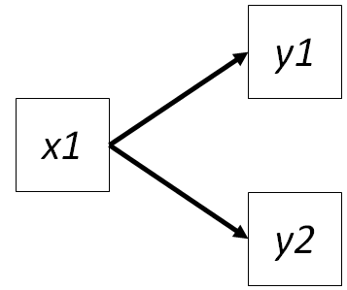
Basics – 8 rules of path coefficients
Rule 6: Unanalyzed (residual) correlations among two endogenous variables are their partial correlations
the two endogenous variables are said to be conditionally independent if the presence of x1 explains all of the variation in y1 and y2

Slide 11
Basics – 8 rules of path coefficients
Rule 7: The total effect one variable has another is the sum of its direct and indirect effects
the total effect of x1 on y2 includes the direct effect as well as the indirect effect mediated by y1
c
a
b
Total effect x1->y2 = (a*b) + c

Slide 12
Basics – 8 rules of path coefficients
Rule 8: The total effect (including undirected paths) is equivalent to the total correlation
The major points to remember are:
standardized coefficients reflect (partial) correlations;
the indirect effect of one variable on another is obtained by multiplying the individual path coefficients (standardized or unstandardized);
the total effect is the sum of direct and indirect paths;
the bivariate correlation is the sum of the total effect plus any undirected paths.

Slide 13
Model saturation
n = 3 (measured predictors)
t = 5 (parameters for relationships = 2, variances on the variables = 3)
5 ≤ 6, so enough information to arrive an unique solution
→ Model is unsaturated

Slide 14
Model saturation
n = 3 (measured predictors)
t = 6 (parameters for relationships = 6, variances = 3)
6 ≤ 6, rule still satisfied, however, model is just identified
→ Model is saturated

Slide 15
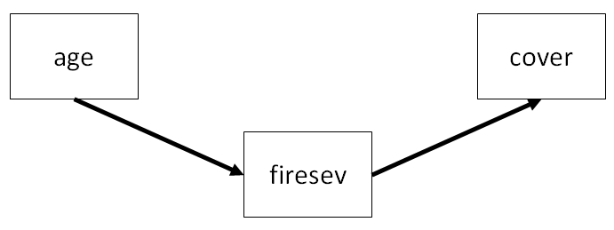
SEM with lavaan
firesev ~ age
cover ~ firesev
Model-fit
Degrees of freedom: 1
P-value (Chi-square): 0.069

Slide 16
SEM with lavaan
R² = 0.191
0.454
-0.437
R² = 0.206
Indirect effect of age on cover: 0.454 ∗ (− 0.437) = −0.198

Slide 17
Piecewise SEM - Basics
Ecological data often violate the assumptions needed for global SEM
Relationships for each endogeneous variable are estimated separately → called local estimation or piecewise SEM
it allows generalized linear models
Only enough data is needed to be able to fit
→ The data must still meet the assumption of individual models

Slide 18
Piecewise SEM – d-separated
Paths might be excluded because there is no a priori reason or mechanism to suspect a causal relationship.
Test of directed separation (d-separated) checks for missing links as part of testing model fit

Slide 19
Piecewise SEM – d-separated
Paths might be excluded because there is no a priori reason or mechanism to suspect a causal relationship.
Test of directed separation (d-separated) checks for missing links as part of testing model fit
Two variables are said to be d-separated if they are statistically independent conditional on their joint influences
we are testing the partial effect of x1 on y2 given y1
independence claim

Slide 20
Piecewise SEM – d-separated
Paths might be excluded because there is no a priori reason or mechanism to suspect a causal relationship.
Test of directed separation (d-separated) checks for missing links as part of testing model fit
Two variables are said to be d-separated if they are statistically independent conditional on their joint influences
we are testing the partial effect of x1 on y2 given y1
basis set is the minimum number of independence claims derived from a path diagram

Slide 21
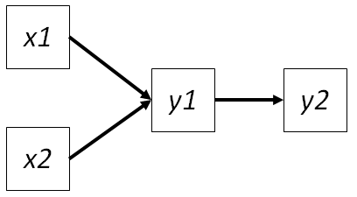
Piecewise SEM – d-separated
Test of directed separation (d-separated) checks for missing links as part of testing model fit

Slide 22
Piecewise SEM – d-separated
Test of directed separation (d-separated) checks for missing links as part of testing model fit
Study area
Month

Slide 23
Piecewise SEM – d-separated
Test of directed separation (d-separated) checks for missing links as part of testing model fit
Study area
Month
Nonsensical claims that might be shown as missing link by the d-test can be “announced” to be correlated and therefore get excluded from the basis set

Slide 24
Piecewise SEM – d-separated
Paths might be excluded because there is no a priori reason or mechanism to suspect a causal relationship.
Test of directed separation (d-separated) checks for missing links as part of testing model fit
Two variables are said to be d-separated if they are statistically independent conditional on their joint influences
we are testing the partial effect of x1 on y2 given y1
basis set is the minimum number of independence claims derived from a path diagram
Χ² and Fisher‘s C can be used to calculate model fit

Slide 25
SEM with piecewiseSEM
Theoretical directed acyclic graph (DAG)

Slide 26
Distance to city centre
Edge density
Green space
Flower richness
Body size

Slide 27
SEM with piecewiseSEM
Theoretical DAG
Extracting single path into single models

Slide 28
Distance to city centre
Edge density
Green space
Flower richness
Body size
M1<-lm(Green space ~ distance to city centre)
M2<-lm(Edge density~ distance to city centre)
M3<-glm(Flower richness ~ Edge density + Green space + Distance to city centre , family = "poisson“)
M4<-lmer(Body size ~ Flower richness + Distance to city centre + (1|Site))

Slide 29
SEM with piecewiseSEM
Theoretical DAG
Extracting single path into single models
Testing model assumptions for each model individually
Running piecewise SEM with R

Slide 30
SEM with piecewiseSEM

Slide 31
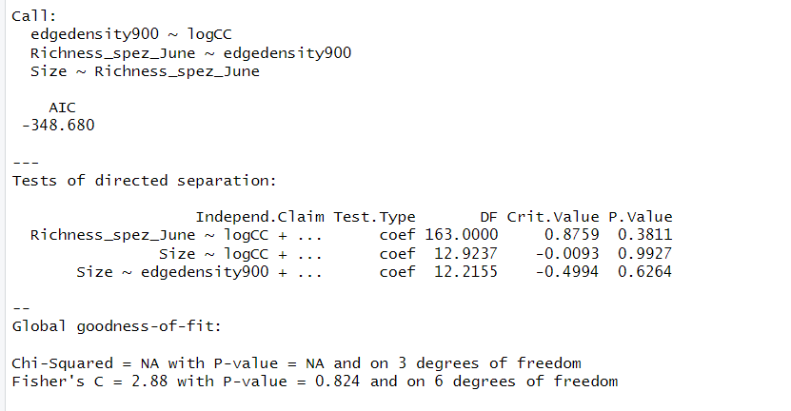
SEM with piecewiseSEM

Slide 32
SEM with piecewiseSEM

Slide 33
SEM with piecewiseSEM

Slide 34
SEM with piecewiseSEM
Theoretical DAG
Extracting single path into single models
Testing model assumptions for each model individually
Running piecewise SEM with
Statistical DAG

Slide 35
SEM with piecewiseSEM

Slide 36
Problems
Model selection: Stick to theoretical Model or do it with AIC and other methods?
Including many predictors and single models can mess up the statistics
Main source: https://jslefche.github.io/sem_book/index.html

