Slide 1
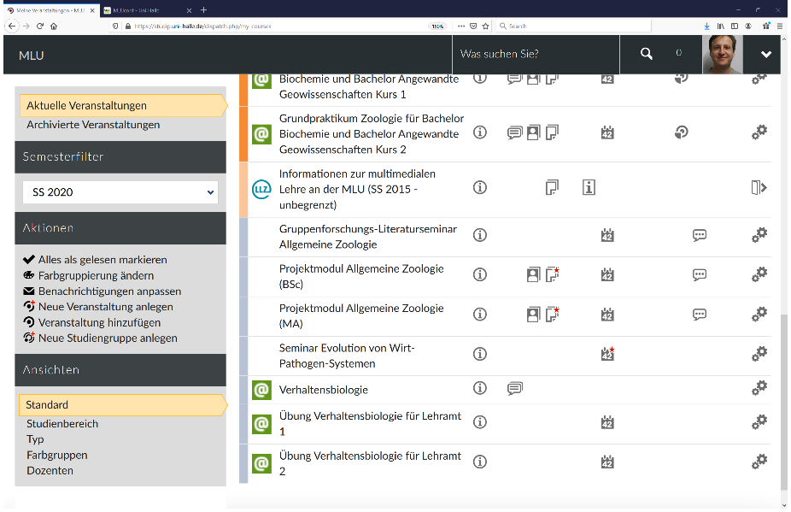
Access MLUconf over StudIP:
Go to the corresponding Lehrveranstaltung and click icon meetings

Slide 2
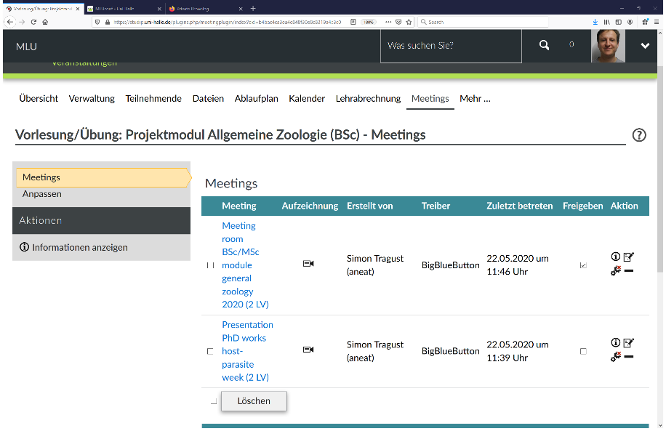
Access MLUconf over StudIP:
Alternatively, enter the Lehrveranstaltung and click meetings

Slide 3
Access MLUconf over StudIP:
Then click the corresponding meeting

Slide 4
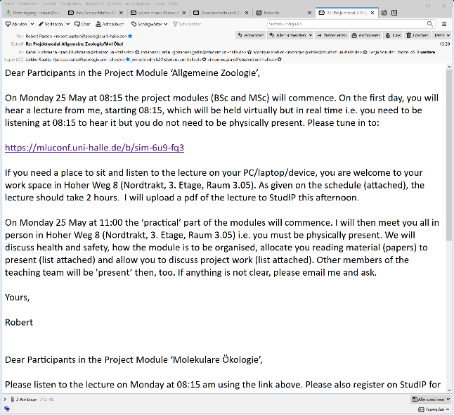
Access MLUconf over link:
Click the link that has been sent you

Slide 5
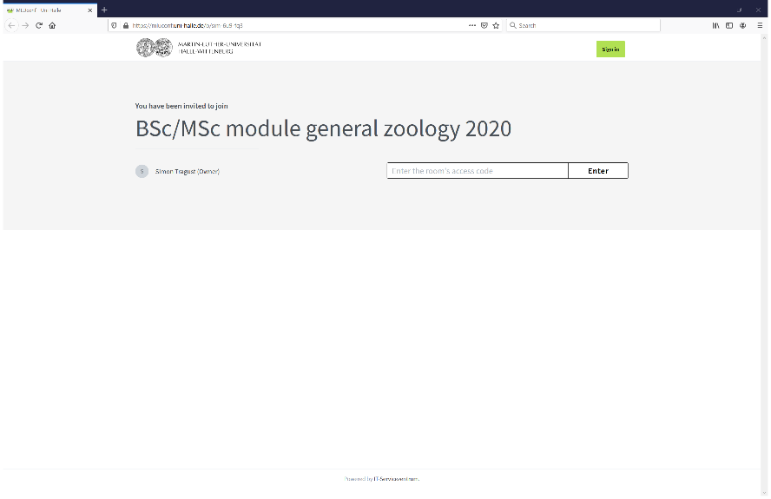
Access MLUconf StudIP and over link:
In any case you will be taken here and have to enter an access code and/or pick a profile name

Slide 6
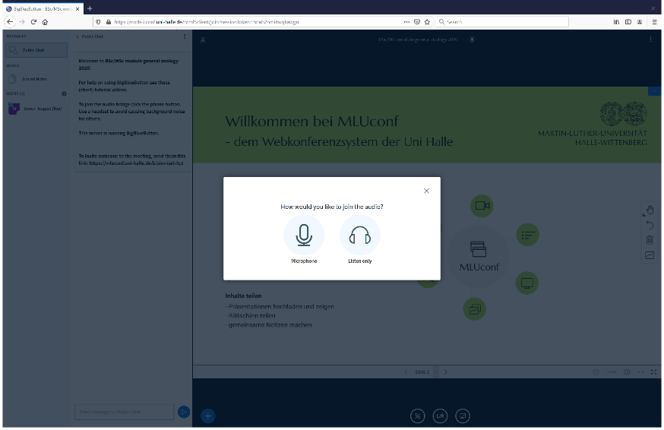
In the meeting room:
You will first have to choose whether you want to enter with microphone or only as a listener

Slide 7
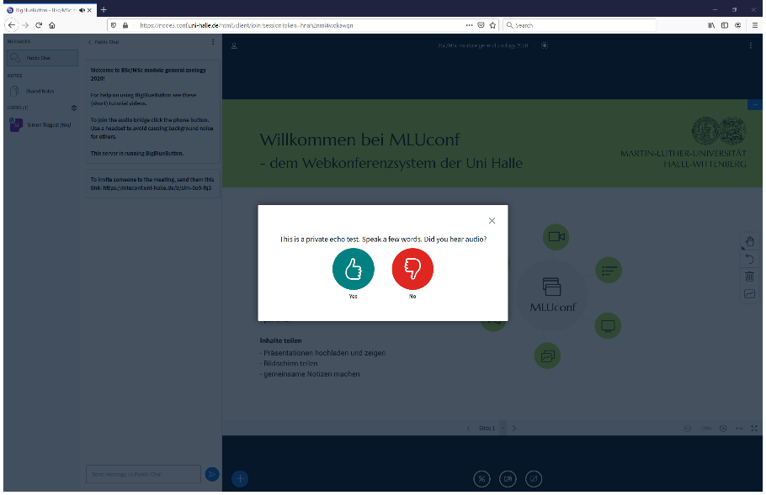
In the meeting room:
With microphone you will need to grant access and an audiotest will be conducted

Slide 8
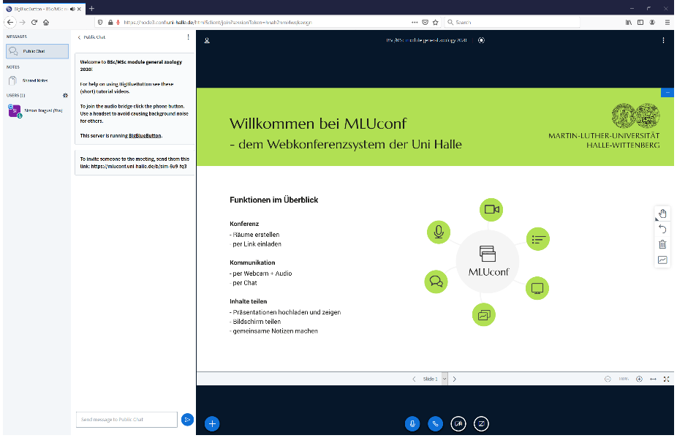
In the meeting room:
You can share your webcam (click see red arrow and grant access)

Slide 9
In the meeting room:
You can share your screen (click see red arrow and grant access)

Slide 10
In the meeting room:
You can upload your presentation if you do not want to share the screen and start it from within the room (click see red arrow). Others will be able to download the presentation

Slide 11
In the meeting room:
Left you see the people in the room and importantly, if you have the rights, when clicking on your name you can for example make yourself a presenter (will allow you to share screen and upload presentation) and you can mute yourself and other stuff.

